Slide 1
Posthuman Futures for Rhetoric, Composition, and Pedagogy
Collin Bjork, Jeffery A. Sternstein, Brent Lucia, Jason Barrett-Fox
Notes:
Posthuman Futures for Rhetoric, Composition, and Pedagogy:
Collin Bjork, Jeffery A. Sternstein, Brent Lucia, Jason Barrett-Fox

Slide 2
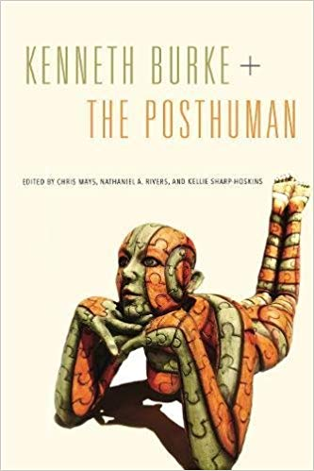
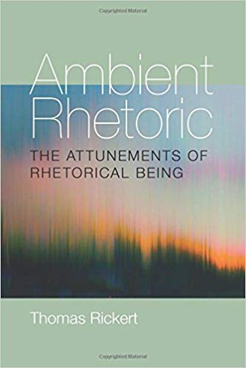
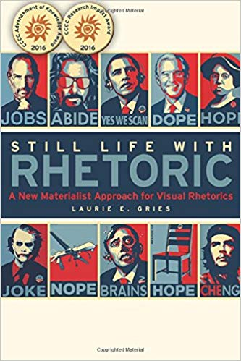
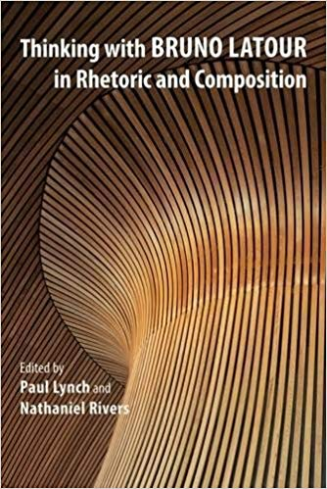
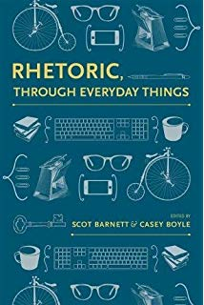
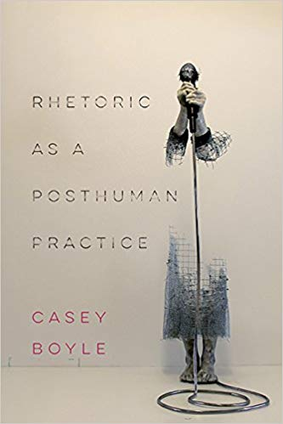
Posthumanism & Rhetoric
Notes:
Posthumanism and Rhetoric:
Recently, the heterogeneous set of theoretical frameworks called “posthumanism” has contributed to a rigorous reimagining of rhetorical theory and practice (Rickert, 2013; Lynch and Rivers, 2015; Boyle, 2018), visual rhetoric (Gries, 2015), physical objects (Barnett and Boyle, 2017), and canonical figures like Kenneth Burke (Mays, Rivers, and Sharp-Hoskins, 2017). Such scholarship has widened the subject matter of our field by urging researchers to account for the role of nonhuman actants (e.g. matter, objects, organisms, assemblages, and technologies) in rhetoric and writing. But, we contend, the futures of rhetoric and composition as a posthuman matter have not yet been fully explored.

Slide 3
Posthumanism & Rhetoric
Ethos
&
Pedagogy
Notes:
Posthumanism and Rhetoric:
This panel extends this line of inquiry by probing the posthuman possibilities of two other key aspects of our field, the concept of ethos and the practice of pedagogy. With two presenters for each topic, this panel aims to generate multiple—sometimes complementing, sometimes conflicting—perspectives on each topic.

Slide 4
Bitcoin and Posthuman Cumulative Ethos
Collin Bjork
csbjork@iu.edu
@collin_Bjork
collinbjork.com/news
Notes:
Bitcoin and Posthuman Cumulative Ethos:
Collin Bjork
csbjork@iu.edu
@collin_Bjork
collinbjork.com/news

Slide 5
Research Context
Ethos is NOT:
Persona
(Cherry, 1988)
Identity
(Anderson, 2007)
Subjectivity
(Ryan, Myers, & Jones, 2016)
Ethos IS:
Rhetorical
Ethical
Notes:
Research Context:
This project emerges from my dissertation research, which investigates how ethos accretes rhetorical force over time. Before I begin, though, it will be useful to define my terms and situate my project.
Following other scholars before me, I carve out subtle but important differences between ethos, persona, identity, and subjectivity. I’m happy to talk about these more in the Q&A, but for now, let me simply point you to the sources I cite here (Cherry, 1988; Anderson, 2007; Ryan, Myers, and Jones, 2016).
Ethos has, however, two key features that—together—distinguish it from its related terms of persona, identity, and subjectivity. First, ethos is rhetorical. In other words, it arises from worldly interactions and suasively impacts those ongoing interactions. Second, ethos is ethical. This features stems from its shared etymology with the word ethics and points to the moral implications of a speakers’ emergent character.

Slide 6
Ethos:
Two Types
“Artistic” (Aristotle)
“Discursive” (Amossy, 2001)
“Invented” (Crowley and Hawhee, 2011)
“Inartistic” (Aristotle)
“Prior” (Amossy, 2001)
“Situated” (Crowley and Hawhee, 2011)
Notes:
Ethos: Two Types:
Ethos—loosely defined by James Baumlin (2001) as “rhetorical character”—is often understood in two complementary ways. First, in its Aristotelian sense, ethos is a part of rhetorical invention and a product of discourse. Aristotle calls this ethos, “artistic,” because it is crafted by the rhetor. Other researchers describe it as “discursive” (Amossy, 2001) or “invented” (Crowley and Hawhee, 2011). This artistic ethos corresponds to kairotic conceptualizations of time because the rhetor crafts an ethos for a particular rhetorical situation that responds to the exigencies of that specific moment in time. A second kind of ethos, called “inartistic” (Aristotle), “prior” (Amossy, 2001), or “situated” (Crowley and Hawhee, 2011), derives from the rhetor’s subjectivity and social position. Race, class, gender, sexuality, ability and authoritative roles (such as “president” or “endowed chair”) give shape—unjustly, in many cases—to a rhetor’s inartistic ethos even before communication occurs. In terms of time, this second ethos is often figured as a-temporal because it typically exists without a clear antecedent event in the rhetor’s life. Even when an inartistic ethos appears based on previous historical events (being elected a departmental chair, for instance), rhetoricians often interpret the authority granted to that inartistic ethos as a static component of the immediate rhetorical context, rather than as an active element of the interaction. In other words, the bifurcation of ethos into two categories—malleable and inert; kairotic and a-temporal—struggles to account for the persuasive impact of ethotic histories on present and future rhetorical engagements. In short, ethos is often characterized as either ephemeral or fossilized but never liquid.

Slide 7
“Cumulative Ethos”
“Artistic” (Aristotle)
“Discursive” (Amossy, 2001)
“Invented” (Crowley and Hawhee, 2011)
“Inartistic” (Aristotle)
“Prior” (Amossy, 2001)
“Situated” (Crowley and Hawhee, 2011)
Notes:
“Cumulative Ethos”
In an effort to attend to the accretive force of ethos over time, I posit a third kind of rhetorical character—“cumulative ethos”—that helps articulate the relationship between artistic and inartistic ethos. Cumulative ethos denotes the nonlinear procedure by which an artistic ethos in one moment may contribute to a subsequent instantiation of a rhetor’s inartistic ethos, and vice versa. According to this model, as each new artistic ethos folds into the past, it jostles and redirects the evolution of the rhetor’s inartistic ethos, which is, itself, the accrual of prior figurations of the rhetor’s artistic ethos. But this inartistic ethos is not passive or without suasive potential in present or future rhetorical interactions. Instead, it retains some degree of its rhetorical power by becoming both the constraints and the components for subsequent iterations of a rhetor’s artistic ethos. In this way, cumulative ethos tracks the evolution of character across subsequent rhetorical situations. Unlike prior theories of ethos, however, cumulative ethos does not refer to a single rhetorical strategy or a feature that an agent possesses. Rather, cumulative ethos identifies an ongoing process of accumulation that shapes a rhetor’s ethos over time.
Figured in this way, cumulative ethos responds to two key problems in rhetorical theories of ethos. First, it resists simplified conceptions of ethos as a static entity, like the Romans who believed that character was marked, in part, by the immoveable force of one’s family name. And, on the other end of the spectrum, cumulative ethos complicates postmodern understandings of ethos as something that exists in an always already fragmented state. While cumulative ethos is heterogeneous, complex, and shifting it does not exist in isolated chunks. Instead, each display of one’s ethos is tied—with different degrees of strength—to prior and subsequent manifestations of that ethos. Together, this chain of ethotic instantiations gives shape to one’s cumulative ethos. Researchers can, in turn, trace the contours of this evolving ethos, however convoluted, as it surges and erodes with time.

Slide 8
Other Kinds of Ethos
“dwelling places” (Hyde, 2004)
“cyberethos” (Fleckenstein, 2005)
“feminist ecological ethos” (Ryan, Myers, and Jones, 2016)
Notes:
Other Kinds of Ethos:
To be sure, scholars have developed other complex ways of understanding ethos beyond its typical bifurcation into “static” and “discursive.” Here are a few examples:
“dwelling places” (Hyde, 2004)
“Cyberethos” (Fleckenstein, 2005)
“feminist ecological ethos” (Ryan, Myers, and Jones, 2016)
Like all theories, they each offer slightly different ways of seeing and, like a Burkean terministic screen, each select and deflect different aspects of ethos. I align my concept of “cumulative ethos” with this group but differentiate it by focusing on the temporal elements of ethos as it accrues rhetorical force over time.

Slide 9
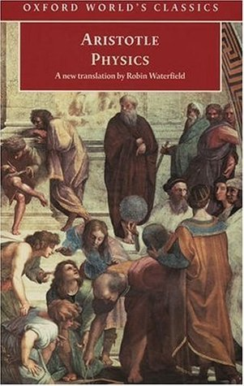
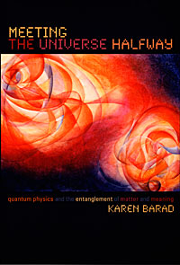
“Cumulative Ethos”
Chronos
Posthumanism
Notes:
“Cumulative Ethos”
To craft my notion of ”cumulative ethos” in a way that allows it to operate with posthuman theories of rhetoric, I link up Aristotle’s temporal concept ”chronos” with the work of feminist new materialists such as Karen Barad and scholars who take up new materialist work in rhetoric such as Laurie Gries.
While kairos helps rhetoricians analyze and deploy persuasive strategies that appropriately respond to the shifting exigencies of a particular moment, such a narrow temporal focus on “right timing” overlooks the important ways that suasive forces also accrete from one rhetorical encounter to the next. To attend to this cumulative rhetorical energy, I examine how the ancient Greek idea of chronos can augment rhetorical notions of time and function as a companion concept to kairos.
Through an analysis of Aristotle’s Physics, I reveal how chronos functions not simply as a quantitative measure of time but, instead, as a dynamic and subjective temporality that arises from—and rhetorically impacts—worldly interactions. Rather than perpetuating a social constructionist view of rhetoric that sees chronos as a rhetorical tool manipulated by rational human subjects, I highlight Aristotle’s surprising ambivalence toward an anthropocentric view of time and extend his theorization of chronos with the help of new materialism. Here, I show how a posthuman view of chronos has three key qualities that govern its rhetorical impact: emergence, interactivity, and sequence. Taken together, these elements construct a picture of chronos as a rhetorically significant material force that emerges from the deep entanglement of nonhuman and human ecologies.
Figured through the lens of chronos, this “cumulative ethos” becomes a decentralized and emergent force: it evolves across digital media platforms and imprints itself on human and nonhuman interactions, accruing strength and speed over time.

Slide 10
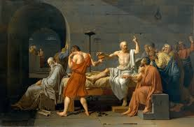
“Cumulative Ethos”
Stakes
Nonhumans
Digital Media
Notes:
Cumulative Ethos
In my dissertation, I explore this concept of cumulative ethos in a variety of contexts.
In the second chapter, I examine the stakes of “cumulative ethos” by looking at the trial of Socrates, someone who was, I argue, executed because of his cumulative ethos.
In the third chapter, I use the concept of ”rhetorical velocities” (Ridolfo and DeVoss) and the problematic (and contested) ethos of celebrity Kanye West to investigate the ways that digital media circulation practices complicate the accumulation of ethos over time.
In the fourth chapter—and in today’s presentation—I test the limits of a posthuman theory of “cumulative ethos” by centering it not on a human subject but on a nonhuman-human network, namely the blockchain technology that undergirds most cryptocurrencies.
Images:
“The Death of Socrates” Jacques-Louis David (Metropolitan Museum of Art, NYC)
Kanye West
Bitcoin

Slide 11
Question(s)
To what extent might we understand the blockchain technology that undergirds most cryptocurrencies as a kind of posthuman cumulative ethos? What are the limits and possibilities of this concept?
How might “posthuman cumulative ethos” help us better understand the issues of credibility and trust involved in the anonymous yet public exchanges that use a decentralized cryptocurrency?
Notes:
Research Questions:
1) To what extent might we understand the blockchain technology that undergirds most cryptocurrencies as a kind of posthuman cumulative ethos? What are the limits and possibilities of this concept?
2) How might “posthuman cumulative ethos” help us better understand the issues of credibility and trust involved in the anonymous yet public exchanges that use a decentralized cryptocurrency?

Slide 12
Traditional Currencies
Notes:
Traditional Currencies:
Currencies are a medium of exchange. Having some currency in my wallet means that I don’t have to give a rhetoric lesson to the cashier every time I buy some apples. And it saves me from having to edit the bartender’s lab report in exchange for a beer. Currencies work because all parties engaged in the exchange agree that the 2.61in. x 6.14in. piece of green paper with dead white dudes faces on it is worth the same thing: $100. Or, in the case of my wallet, more like $1.
Using currency, moreover, is a way to simplify trade between strangers. I don’t know you, and you don’t know me. But if you have something I want, and I have something you want, then—according to traditional understandings of open markets—it is in our mutual interest to participate in exchange. But trading with strangers can be risky. How do I know you selling me non-worm-infested apples? And how do you know that my lessons in rhetoric are not just demagoguery? This is especially true when I want the apples today, but I cannot teach the rhetoric lesson until tomorrow. How do you know I will show up at all?
Commercial exchange, in short, requires trust. And currencies are the material manifestation of that trust.
In prior centuries, many currencies built their credibility on the gold standard. In other words, central governments established credibility for their currency by claiming—see how this verb makes it rhetorical? The gold standard is not so much a standard as it is a persuasive argument about the value of country’s currency—that each bill was tied to a finite and (relatively) stable quantity of gold and that the central government possessed enough gold, ostensibly, to buy back all of the currency it produced.
Today, fiat currencies--such as US dollars—derive their credibility from the governments and institutions that produce them. Roughly speaking, it works like this: if people trust in a central government and their ability to manage the economy and if people are not afraid that their government may go to war, then that government’s currency typically retains value. But without trust in the government institution that manages the economy and produces bank notes, currencies quickly lose their value.
Photo: Bills from different global currencies (Bjork)

Slide 13
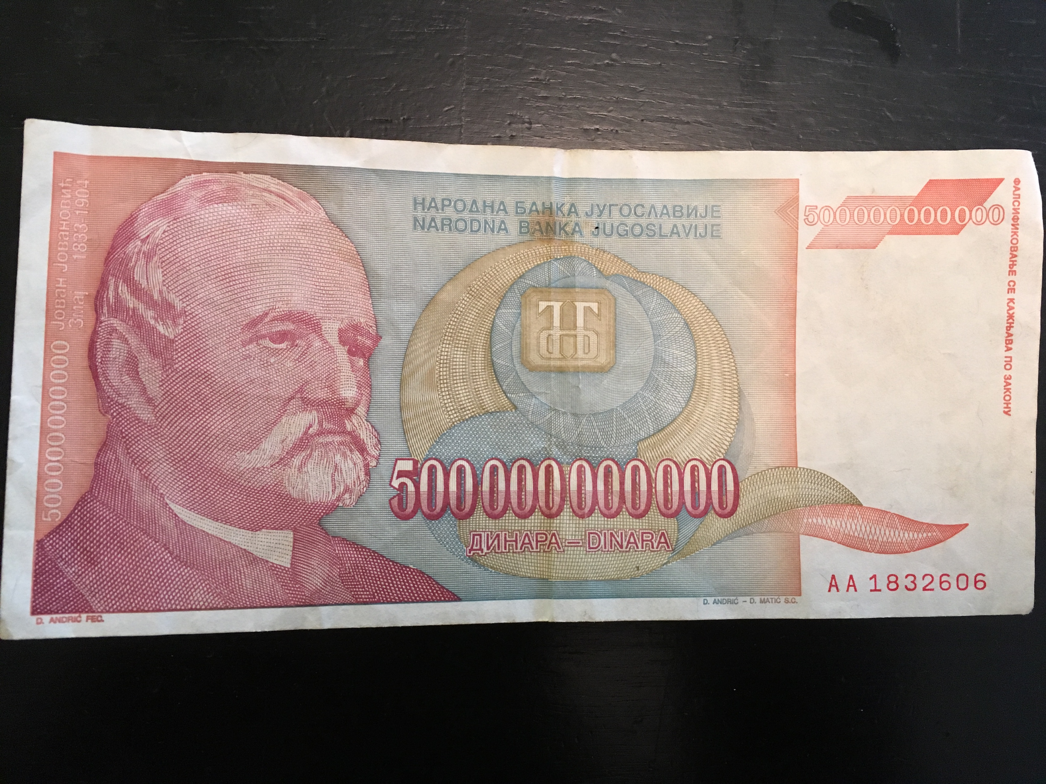
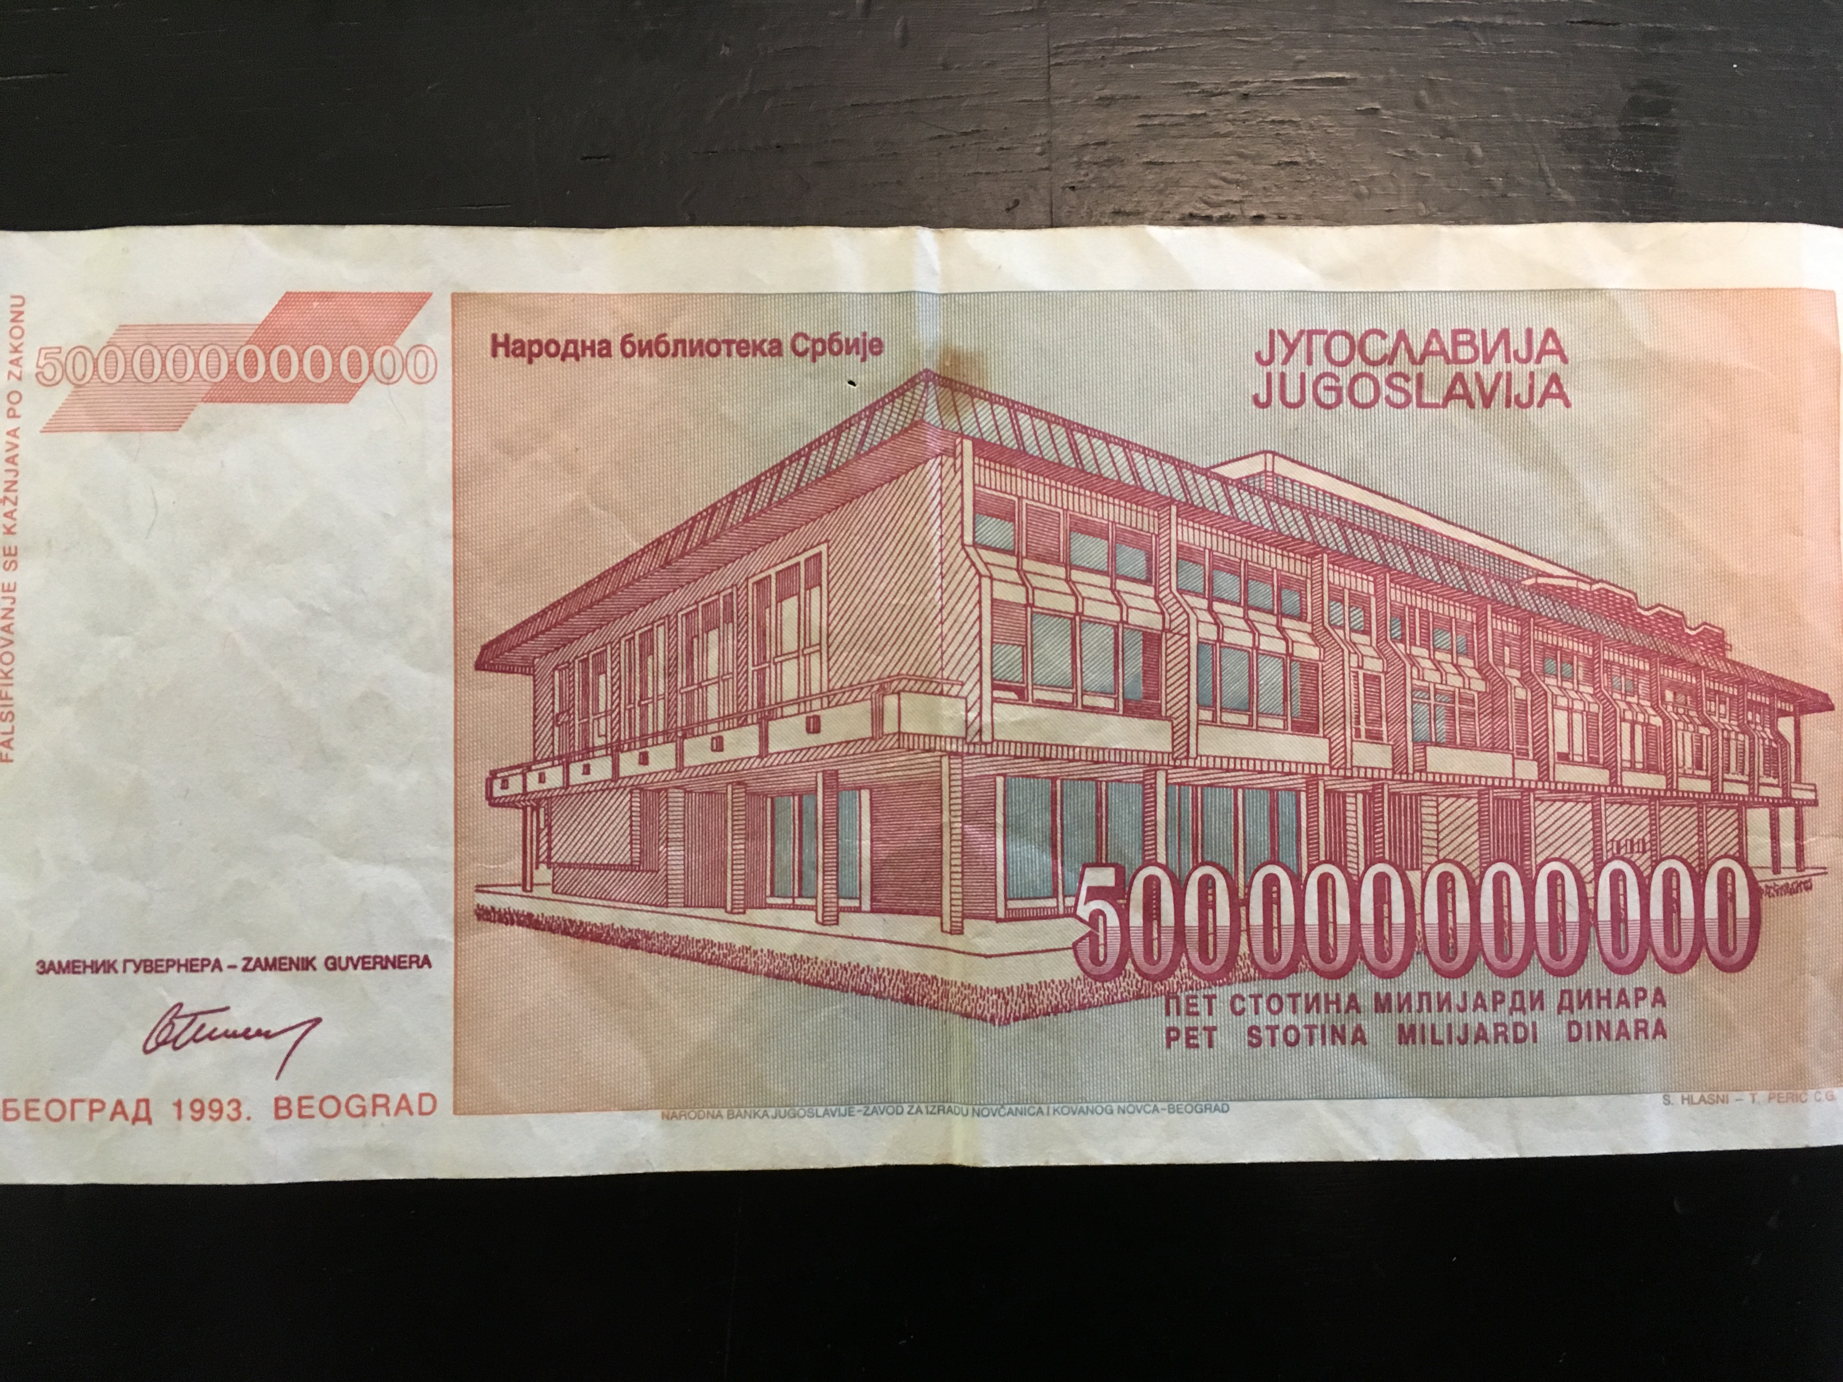
Traditional Currencies
Notes:
Traditional Currencies:
War is often a time when trust in currencies wanes and the risk of inflation is high. Above you will see a 500,000,000,000 dinar bank note from the National Bank of Yugoslavia from the 1990s civil war. Friends of mine from my time working as a Fulbrighter at the University of Montenegro tell me that their parents were paid in bags of these 500 billion dinar notes. (This is, by the way, the second largest bill ever printed. The largest was Zimbabwe’s 1,000,000,000,000 note, printed during the period of hyperinflation that they experienced early in the 21st century.) There was not, suffice it to say, much trust in this currency (or its government) at the time.
In sum, currencies serve as a material manifestation of the trust needed for two strangers to exchange goods or services. Crucially, however, this trust is built on the credibility of a third-party institution (a central government) that regulates those exchanges.
Photo: Front and back of 500,000,000,000 dinar bill from 1990s Yugoslavia (Bjork)
Footnote about Cuba and its two currencies insofar as it relates to credibility…

Slide 14
Cryptocurrencies
Notes:
Cryptocurrencies:
Cryptocurrencies, on the other hand, establish credibility differently. Cryptocurrencies are digital currencies that use cryptography to regulate the supply of money on the market and to secure financial exchanges from double spending. Cryptocurrencies use technology, rather than a central bank or government, to build trust in them as a medium of exchange. More specifically, cryptocurrencies build their credibility on some version of the blockchain technology that undergirds them.
Sources:
Narayanan, et al. Bitcoin and Cryptocurrency Technologies: A Comprehensive Introduction (2016)
Vigna and Casey. The Age of Cryptocurrency: How Bitcoin and the Blockchain are Challenging the Global Economic Order (2016)
Images: Digital representations of ‘coins’ from five popular cryptocurrencies: Bitcoin, Litecoin, Ripple, Ethereum, and Dash (formerly Darkcoin).

Slide 15
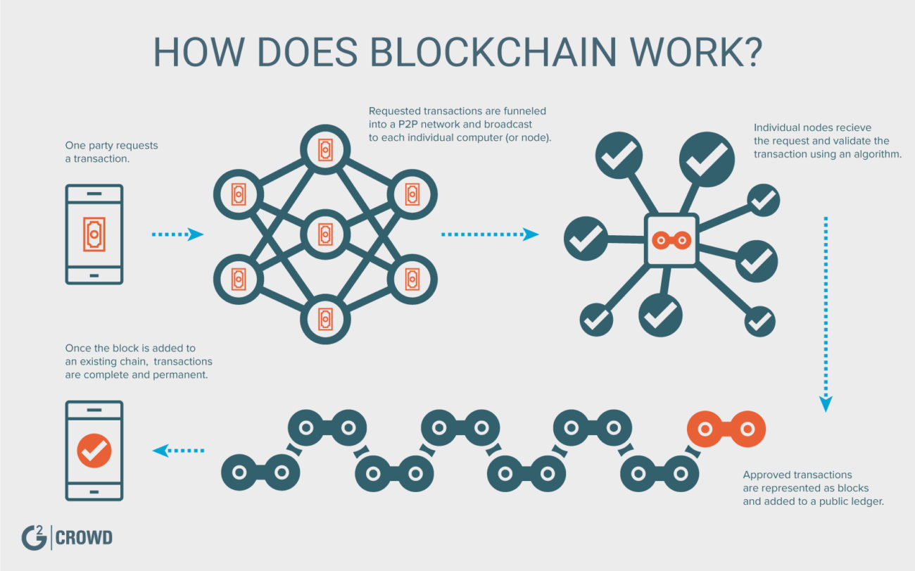
Blockchain
Notes:
Blockchain:
So how does Blockchain work?
One party requests a transaction. Requested transactions are funneled into a peer-to-peer (P2P) network and broadcast to each individual computer (called nodes) in that network. These individual nodes receive the request and validate the transaction using an algorithm. Approved transactions are represented as blocks and added to public-facing ledgers. Once the block is added to an existing chain, transactions are complete and permanent.
This blockchain technology functions, I suggest, in part like my understanding of “cumulative ethos.” Like cumulative ethos, blockchain develops credibility over time by displaying the ledger of that coin’s past transactions publicly. A “kairotic” sense of trust based solely on the credibility of the owner is insufficient to complete a transaction. Instead, trust in the cryptocurrency is generated by showing—to the new buyer—the entire chronological history of exchanges that coin has participated in. In short, the chronological history of that coin establishes the trust necessary for both anonymous parties to complete the transaction.
Blockchain is different than cumulative ethos, however, in that blockchain does not gain or lose more credibility as the chain gets longer [like I suggest in my earlier work that ethos does]. Instead, blockchain simply requires a chain, of any length, to establish baseline trust that the coin in question is now solely possessed by the new owner. A human subject’s cumulative ethos, on the other hand, does accrue more (or sometimes less) rhetorical power as it moves through time (and space)...at least according to my earlier research on Socrates and Kanye West. In other words, the longer the ”chain” of trustworthy kairotic interactions that subject has with audiences, then the more credibility that subject has. But it is not the case that a longer blockchain is necessarily more credible than a shorter chain of transactions.
This is where the next aspect of the blockchain technology comes in: the public-facing ledger required to trace the entire history of transactions of a single crypto-coin does not reside on any single server in the possession of any single individual or machine. Rather, the public ledger is distributed across a network of machines and humans. In this way, blockchain derives credibility from a vast network of machines and humans, rather than from a single authority like a central bank or government. In terms of blockchain, then, an ethos emerges from the ongoing relationship between anonymous publics, algorithms, and the machines that process and store the data.
Thus, while my conceptualization of a posthuman cumulative ethos in earlier work already accounts for ethos being a rhetorical force that emerges from the intra-actions (Barad) of nonhumans and humans, centering the concept of ethos on nonhuman entities, like traditional currencies and cryptocurrencies, shifts our understanding of ethos by foregrounding the networks of nonhumans and humans that give rise to an apparent ethos.
It is not surprising, I argue, that fiat currencies often have the faces of famous individuals on them. Those images function as rhetorical signifiers of the ethos of that currency, demonstrating its viability, trustworthiness, and prowess. The ethos of a fiat currency is yolked to the ethos of the government, its leaders, and its heroes. It is that centralized knowable ethos that then makes possible the exchange of goods and services between strangers who may not trust each other.
Cryptocurrencies, however, are different. They derive their ethos not from a single authoritative institution metonymically represented by the image of a human leader. Rather, cryptocurrencies generate their ethos from the chronological record of transactions and publicly archived ledger that comprises the blockchain technology.

Slide 16
Currency vs. Commodity
Notes:
Currency vs. Commodity
Blockchain, however, is not the only thing that contributes to the emergence of a cryptocurrency’s cumulative ethos.
Its peculiar status both a currency and a commodity adds complexity to ongoing evolution of its ethos.
While currencies are often viewed primarily as a medium of exchange, sometimes currencies are also treated as commodities. Like traditional commodities (oil and corn, for example), currencies can be bought and sold, and they can gain and lose value over time. And although you cannot consume currencies in the same way that you can eat corn or burn fuel, some investors view currencies as objects to be possessed and hoarded. In fact, most people who invest in the commodity market do so not to actually consume those commodities but rather to the benefits of a relatively stable market. These commodity markets are stable because investors trust that-–in both the short and long term—humans will need corn to eat and oil to burn, therefore there is little risk in investing in traditional commodities. Fiat currencies, too, often provide investors with little financial exposure provided that consumers trust in the stability of the government and its economy at the time.
Cryptocurrencies, however, are far less stable. This is, in part, due to their novelty and their seeming mysteriousness. But it is also due to their lack of fashioning an ethos around a centralized institution. Instead, the peer-to-peer, networked, and public ethos of cryptocurrencies exposes them to manipulation by individual actors.
Speculative investors, for example, sometimes buy gigantic sums of new cryptocurrencies for pennies and then pay other individuals in those cheap digital coins to promote that new cryptocurrency to other investors on social media platforms. This manufactured trust in the new cryptocurrency, in turn, rapidly drives up its value until the original speculative investors quickly liquidate their digital coins and make loads of money—in a fiat currency, like USD—while leaving other holders of that cryptocurrency with now-worthless digital coins.
Thus, although blockchain technology provides users with credibility in that digital currency as a medium of exchange, cryptocurrencies—like rhetoric itself—are not immune to malevolence. Indeed, cryptocurrencies (like fiat currencies) share a dual role as BOTH currency and commodity that disrupts the networked ethos established by blockchain technology.
Images: Global bills (Bjork) and global commodies: oil, coffee, and gold (from XM Special Report 2017, https://www.xm.com/special-report-commodities-end-2017-on-strong-note-set-for-a-comeback-in-2018-66306)

Slide 17
Silk Road
Notes:
Silk Road:
Economies vs Ecologies….!!!
Image: Homepage of no-closed Silk Road website, an anonymous online marketplace

Slide 18
THANK YOU!
Collin Bjork
csbjork@iu.edu
@collin_Bjork
collinbjork.com/news
Notes:
Thank you!
Collin Bjork
csbjork@indiana.edu
@collinbjork
www.collinbjork.com

